Slide 1

SOA -Service Oriented Architecture Relevant for Land Information Systems ?
A PRACTICLE EXAMPLE : Armenian Real Property Information System
Steinar Høseggen, Geomatikk IKT AS
steinar.hoseggen@geomatikk.no

Slide 2
Steinar Høseggen
M.Sc in Computer Science /Information Technology, University of Trondheim, Norway
30 years experience in System development
    Utility Mapping and Information System
    Real Property Information System
    Restrictions and Regulation Information Systems
    Road Network and Trafic Systems
Standardization
    ISO 19100 Geographic Information/ Geomatics
      Project leader and author of ISO 19109 Rules for Application Schema
    Standards in Norway
      GeoIntegration

Slide 3
Norwegian Mapping Authority
operating well functioning centralized cadastre and land registration systems in Norway
  integrated with NSDI
supervisior for and assisting several countries within Cadastre, Real Property and Mapping based on Norwegian funding
  > 20 projects in West Balkan and post Soviet countries
EXAMPLES
  KCLIS – Kosovo Cadastre Land Information System
  ARPIS – Armenian Real Property Information System

Slide 4
..a new real property information system in ARMENIA
Objective
  To establish a well-functioning and transparent registration system for securing land ownership and supporting financing and lending through the use of real property as security for loans. In addition, to establish a system for provision of property maps and other maps
Grants
  The Norwegian Ministry of Foreign Affairs, on behalf of the Norwegian Government, has allocated a grant towards the Project
Implementation
  International tender

Slide 5
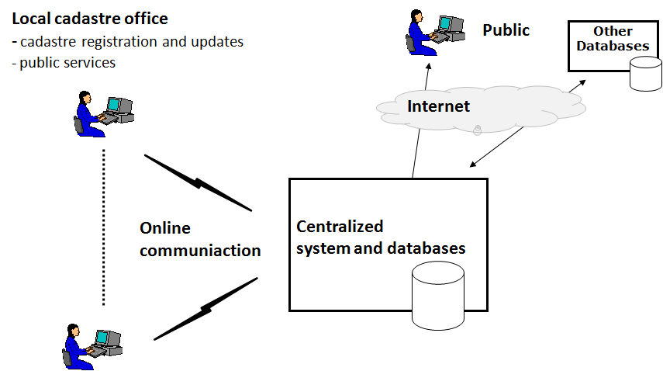
..a new real property information system in ARMENIA The Vision
Cadastre objects
- Textual data
- Graphical data
Rights
Rightholders
Restrictions
Valuation
Applications
Documents
ro

Slide 6
..a new real property information system in ARMENIA The Vision
is NOT a special Armenian Vision
  during last 10-15 years, many countries have been developing similar systems
  experience shows that these projects do not have a high success rate
Question: Why have many countries NOT succeeded ?
  Stand-alone systems with self-contained, proprietary software?
  Software constrained to a single hardware environment?
  System complexity ?
  Huge amount of data?
  Integration of different system technologies ?
  Out-dated technology?
  Seperate stand-alone system ?
  ....... ?
Can a new approach on System Architecture lead to success ?
ro

Slide 7
SOA – Service Oriented Architecture Principles
The user shall experience the system as unified
Decomposition into logical and physical modules / components
Each module is independent and essential,
Each module controls the data, which it is responsible for
  Real property data may be administered by more than one module using common keys
Data exchange and interoperability between the modules by services
  Open standards
Preparing for Open Source Software
Map Provider
Web Services
Centralized System Operation

Slide 8
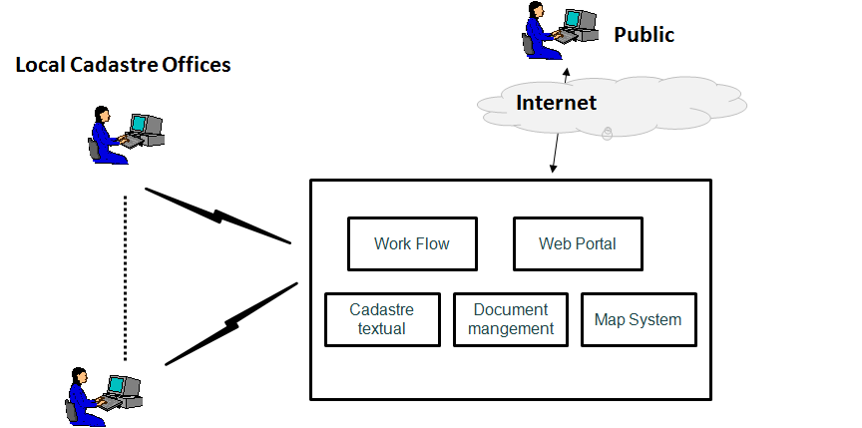
..a new real property information system in ARMENIA The Main Architecture
ro

Slide 9
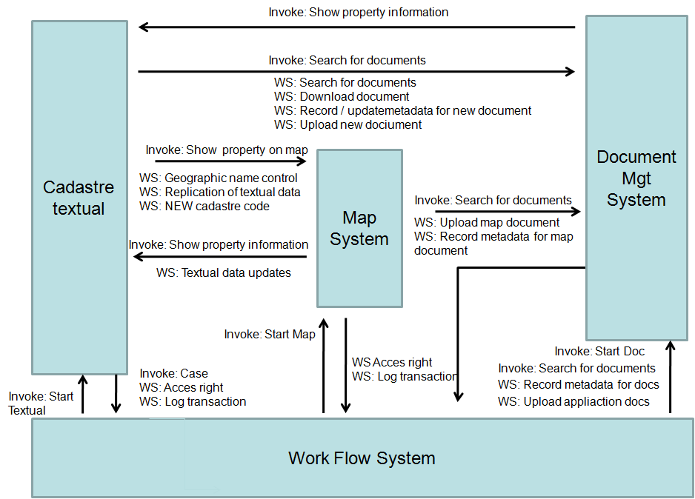
..a new real property information system in ARMENIA SOA - EXAMPLE
ro

Slide 10
SOA – Service Oriented Architecture
Some advantages
Less complexity
Standard system components can be applied for implementation
Different technologies can easily operate together
Data will only be registered once
Welcome use of Open Software
Flexibility: Change of software components without changing the whole system
Thank you for your attention.
ro

