Slide 1
Ghana Land Information System(LIS): Experience and Future Plans
By Rafiq Doun-Naah
Land Information Systems

Slide 2
Background
Experience
  Development challenge
  Development experience
  Project Management Experience
  No consideration of t
Future Plans

Slide 3
BACKGROUND
General Overview of the Ghana Land Administration Project (LAP) www.ghanalap.gov.gh
  Ghana Land Problems prior to 1999

Slide 4
BACKGROUND Cont’d
  Ghana Land Policy to the rescue
    Formulated in 1999 with the long-term goal of stimulating economic development, reducing poverty and promoting social stability by improving security of land tenure, simplifying the process for accessing land …
    LAP implementing the policy

Slide 5
BACKROUND Cont’d
  Detailed Exposition of Component 3
    Development of Cadastre and Land Information System
    Improvement in Geodetic Reference framework
    Improvement of deeds registration system
    Establishment of National Land Valuation database
    Pilot systematic land titling and registration

Slide 6
Experience - Ghana LIS Phase I
Objectives of the Ghana LIS Phase I
  Design and develop components that support Systematic Land Title Registration Activity of the Ghana LAP and to introduce staff to a digital working environment
  To prevent the continuous generation of manual records

Slide 7
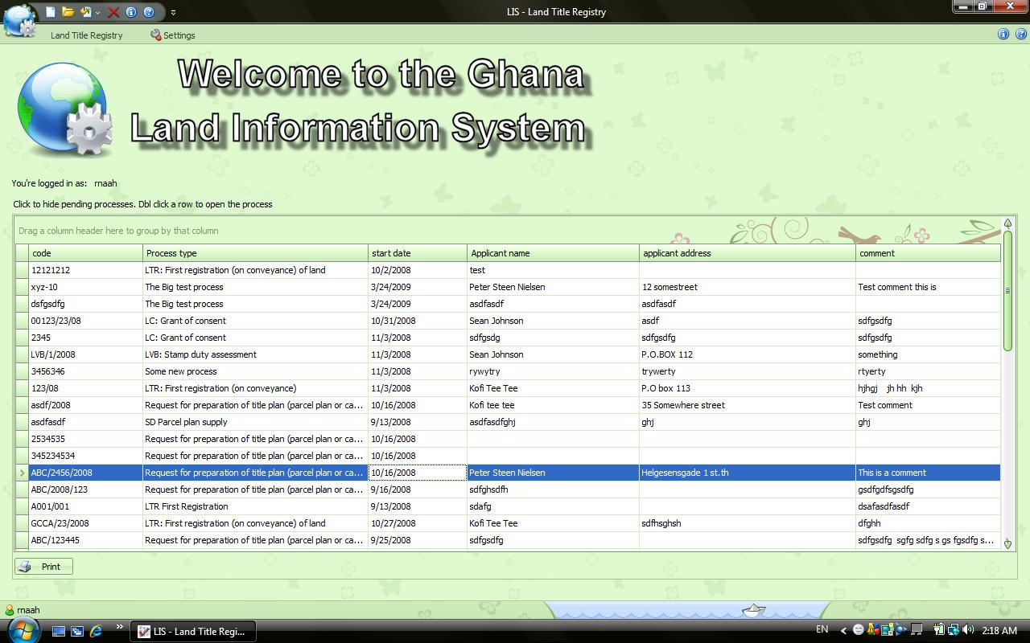
EXPERIENCE - Development Challenges
Escalated requirements (Scope creep)
Inconsistent development Team
Insufficient participation of counterpart staff

Slide 8
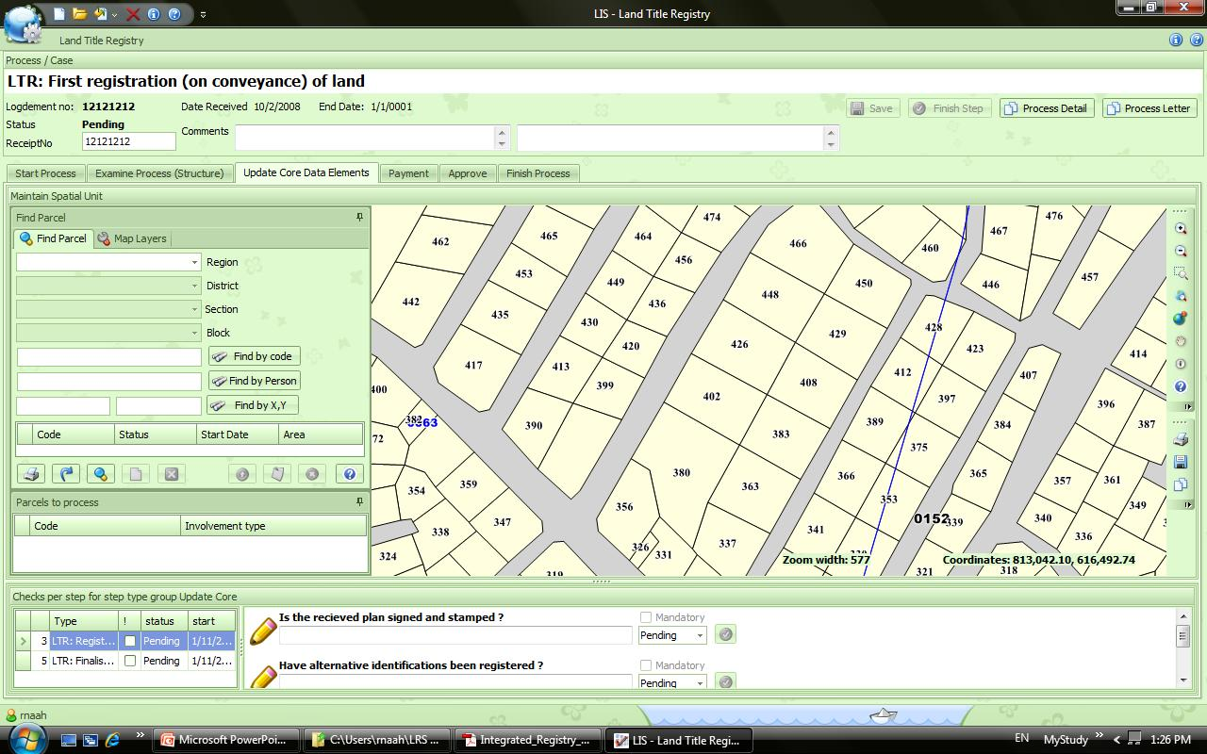
EXPERIENCE – Dev’t Lessons
Systems development needs comprehensive requirements, analysis and design before development
Needs participation of technical staff

Slide 9
FUTURE PLANS
Design and develop a fully functional and integrated land information system based (preferably) on the SOA Architecture using Open Source Technologies and Principles.
To focus on the integration with other information systems and scaling up of the LIS to cover the whole country and include ALL of the processes of the relevant LSAs.

Slide 10
Future Plans
Convert and enter existing data into the System when it is stabilized and is guaranteed to work successfully.
Develop both technical and functional human resource to operate and maintain the system.

